Slide 1
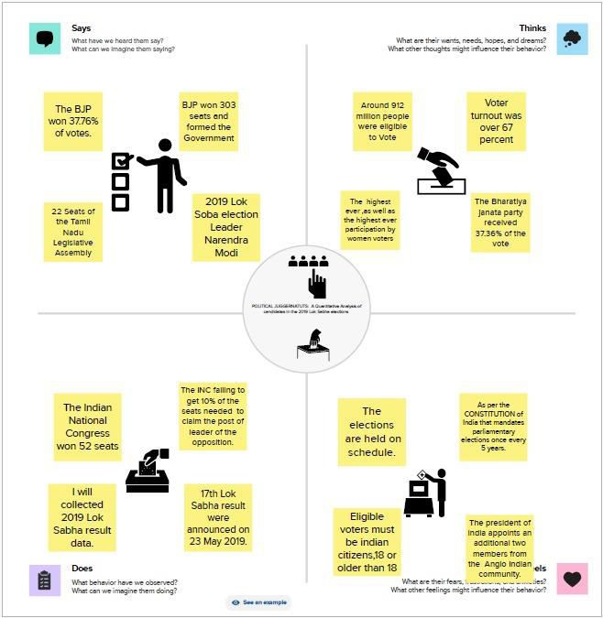
INTRODUCTION
  OVERVIEW
General elections were held in india in seven phases from 11 april to 19 may 2019 to elect the members of the 17th lok sabha. Votes were counted and the result was declared on 23 may. The election resulted in a landslide victory for the BJP which won 303 seats and formed Th government.
  Purpose
The election resulted in a landslide victory for the BJP which won 303 seats and formed the government. Around 912 million people were eligible to vote, and voter turnout was over 67 percent-the highest ever, as well as the highest ever participation by women voters.
PROBLEM DEFINITION & DESIGN THINKING
  EMPATHY MAP

Slide 2
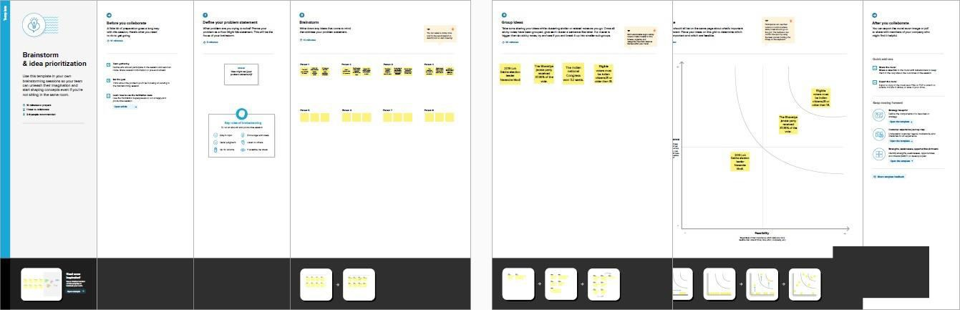
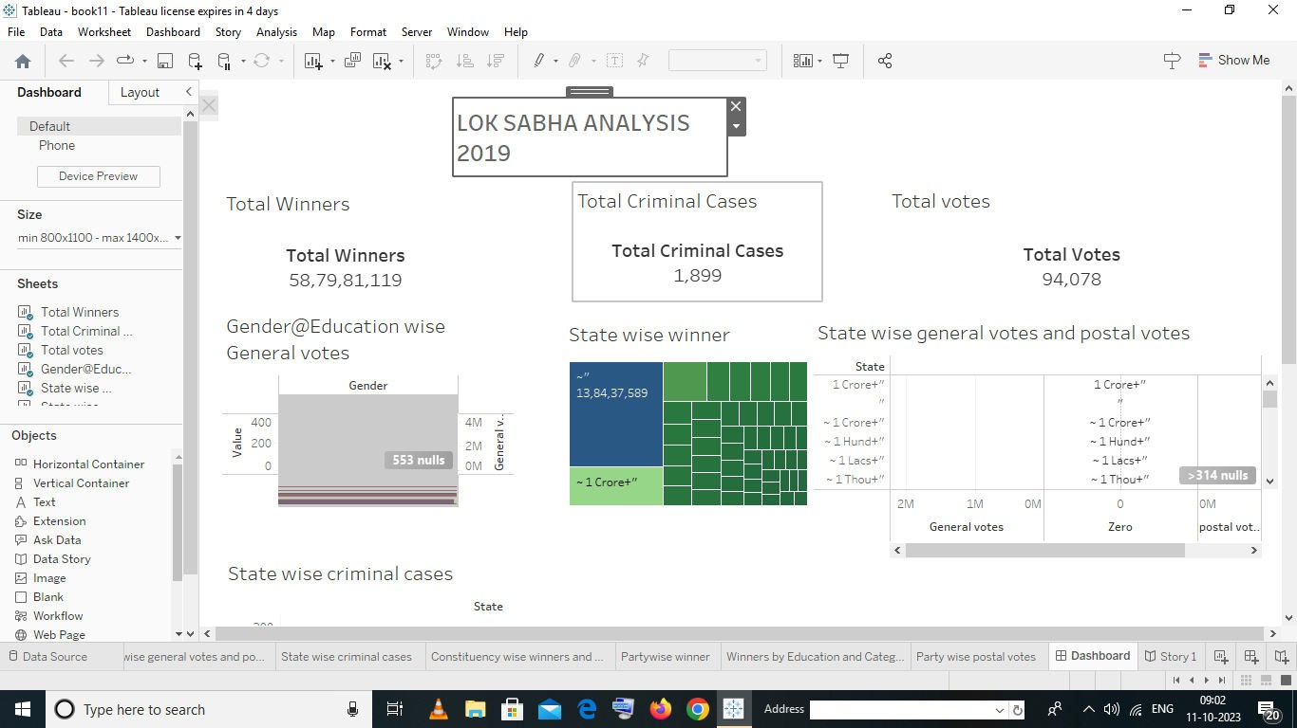
2.2 IDEATION & BRAINSTORAMING MAP
3. RESULT

Slide 3
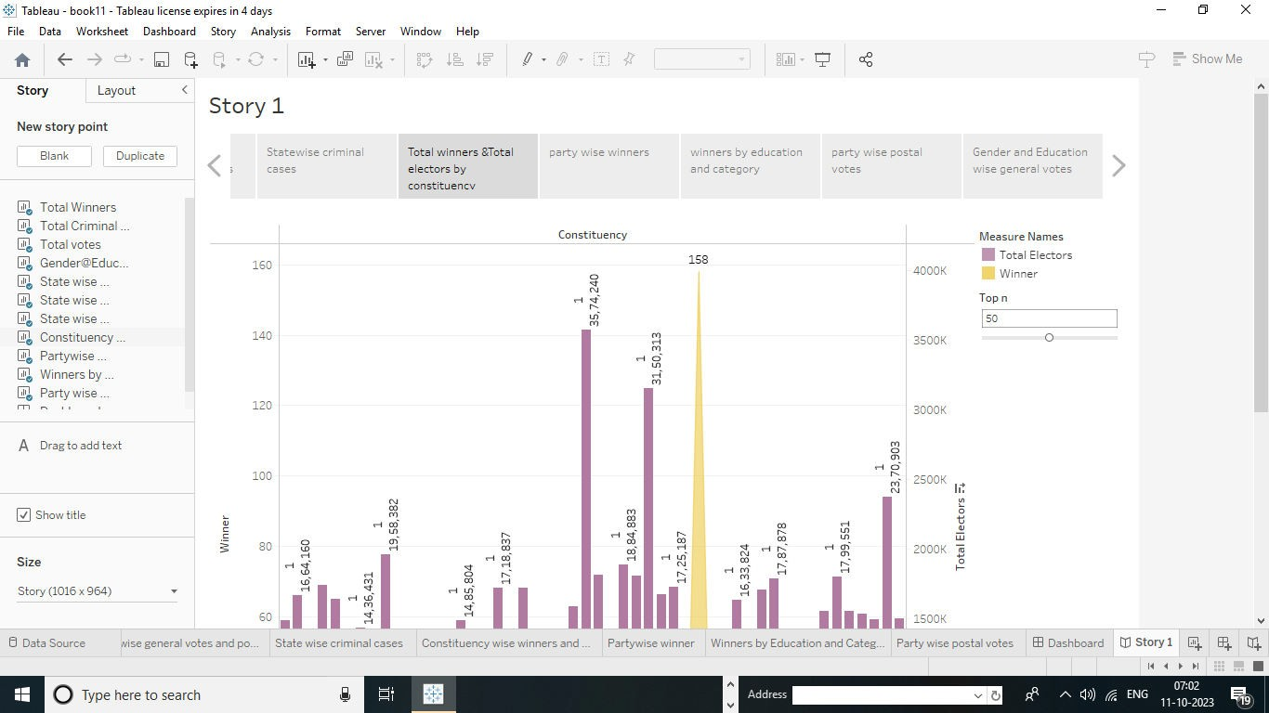
ADVANTAGES AND DISADVANTAGES
  ADVANTAGES
It helps in proper functioning of democracy through the system of checks and balances. No confident motion can only be introduced and passed in the lok sabha. So, it controls the despotism of the government . money bills can be only introduction in the lok sabha.
  DISADVANTAGES
The congress party compaign highlighted “agrarian distress” as an election issue. The BJP campaign highlighted that the congress party had been in power or five generations of the nehru dynasty and its past promises and campaign issues have been empty.
APPLICATIONS
General elections were held in india in seven phases from 11 april to 19 may 2019 to elect the members of the 17th lok sabha. Votes were counted and the result was declared on 23 may. The election resulted in a landslide victory for the BJP which won 303 seats and formed the government. BJP’s sitting MP from navasari victory margin in the 2019 lok sabha elections. He defeated his nearest congress rival DB patil by a record 6.89 lakh votes.

Slide 4
CONCLUSION
Voter turnout of 7th phase estimated till 8pm-total 62.87%; bihar-53.36%, himachal pradesh- 69.73%, madhya pradesh-71.44%,punjab-62.45%,uttar pradesh-57.86%,west bengal-73.51%, Jharkhand-71.16%,chandigarh-63.57%. on Sunday in the seventh and the final phase of the ok sabha election held in 59 constituencies across eight states and union terrtores nearly 61%voters
FUTURE SCOPE
The next indian general election is expected to be held in indian between april and may 2024 to elect the members of the 18th lok sabha. Prime minister narendra modi-led national democratic alliance(NDA) may score a clear majority with 315 seats in a house of 543, if lok sabha elections are held now, says india TV-CNX opinion poll projection, final results of which were telecast on the news channel today.

